Slide 1
CSC 3210 Computer Organization and Programming
Lab Work 7
Dr. Zulkar Nine
mnine@gsu.edu
Georgia State University
Spring 2021

Slide 2
Learning Objective
Data Transfer,
Arithmetic instructions with variables

Slide 3
Disclaimer
The process shown in these slides might not work in every single computer due to Operating system version, Microsoft Visual Studio versions and everything.
If you find any unusual error, you can inform the instructor.
Instructor will help you resolve the issue.

Slide 4
Attendance!

Slide 5
Lab Work 7 Instructions
Lab 7(a) : Mov instructions
Lab 7(b): Movzx and movsx instructions
Lab 7(c): Direct-Offset Addressing
Lab 7(d): xchg instruction
Lab 7(e): Expression evaluation
Due Date: 03/05/21 11:59 PM

Slide 6
Plan early …
You have one week time to submit the lab
Start early
If you have issues
Email TA or instructor
Stop by during office hours
Start working at the last moment is not a good idea.
Appendix shows how to create a new project.

Slide 7
Lab 7(a) Mov instruction
Submission

Slide 8
Data Transfer Instruction: Mov
Create a new Project to run the following program.
Examine the error message generated by MASM assembler
Do the visual studio errors’ messages show the type of error?
Correct those errors
Build and run the program using the debugger
.data
count BYTE 100
wVal WORD 2
wVal2 word 4
.code
mov bl, count
mov ax, wVal
mov count,al
mov al, wVal
mov ax, count
mov eax, count
mov wVal2,wVal

Slide 9
Submission Instruction 7(a)
There is an answer sheet attached to the lab
After fixing errors, build your project without errors.
Take a screenshot of code and the message showing that build is successful.

Slide 10
Lab 7(b)
Submission

Slide 11
Movzx and Movsx
.data
myByte1 BYTE 9Bh
.code
mov bx, 0A69Bh
movzx eax, bx ;EAX =
movzx eax, myByte1 ;EAX=
mov bx,0A69Bh
movsx eax,bx ;EAX =
Create a new project to run the following program.
Build and run the program using the debugger
Examine the content of the registers

Slide 12
Submission Instruction
Debug through each line of your code.
Execute the instruction
Take a screenshot of the code and register window
Record the line number, instruction, Register values in the answer sheet.
Also add the screenshot
Then explain the register contents.

Slide 13
Lab 7(c)
Submission

Slide 14
Data Transfer Instructions: Direct-Offset Addressing
Create a new Project to run the following program.
Build and run the program using the debugger
Examine the content of the registers
.data
arrayD DWORD 10000h,20000h, 30000h
.code
; Direct-Offset Addressing (doubleword array):
mov eax,arrayD ; EAX =
mov ebx,[arrayD+4] ; EBX =
mov edx,[arrayD+8] ; EDX =

Slide 15
Submission Instruction
Debug through each line of your code.
Execute the instruction
Take a screenshot of the code and register window
Record the line number, instruction, Register values in the answer sheet.
Also add the screenshot
Then explain the register contents.

Slide 16
Xchg instruction
A review

Slide 17
XCHG instruction
.data
val1 WORD 1000h
val2 WORD 2000h
.code
; Memory-to-memory exchange:
mov ax,val1 ; AX =
xchg ax,val2 ; AX= , val2=
mov val1,ax ; val1 =

Slide 18
Exchange item in an array
Create a new project to run the following program.
Build and run the program using the debugger
Examine the content of the registers
rearranges the values of three doubleword values in the following array as:
1,2,3 ----------→ 3, 1, 2.
See next slide -→

Slide 19
Data Transfer Instructions : Direct-Offset Operands
.data
arrayD DWORD 1,2,3
Step1: copy the FIRST value into EAX and exchange it with the value in the SECOND position.
mov eax, arrayD
xchg eax, [arrayD+4]
Step 2: Exchange EAX with the THIRD array value and copy the value in EAX to the FIRST array position.
xchg eax,[arrayD+8]
mov arrayD,eax

Slide 20
Lab 7(d)
Submission

Slide 21
Submission instruction.
Create a new project to run the following program
Declare an array:
arrayB WORD 1,2,3,4
Write code to Rearrange the array as follows:
4,3,1,2
Debug the code until you reach “INVOKE ExitProcess, 0”
Add the screenshot of your code in the answer sheet.

Slide 22
Lab 7(e)
Submission

Slide 23
Submission Instruction
Create a new application to run the following program.
The data segment is provided:
.data
Val1 SWORD 23
Val2 SWORD -35
Val3 SDWORD 4
Evaluate the following expression :
EBX = (-Val1 + val2) + (val3*3)
You can only use Mov, Movsz, Movzx, Add, Sub instructions.
Build and run the program using the debugger
Examine the content of the registers

Slide 24
Appendix
Create a Project

Slide 25
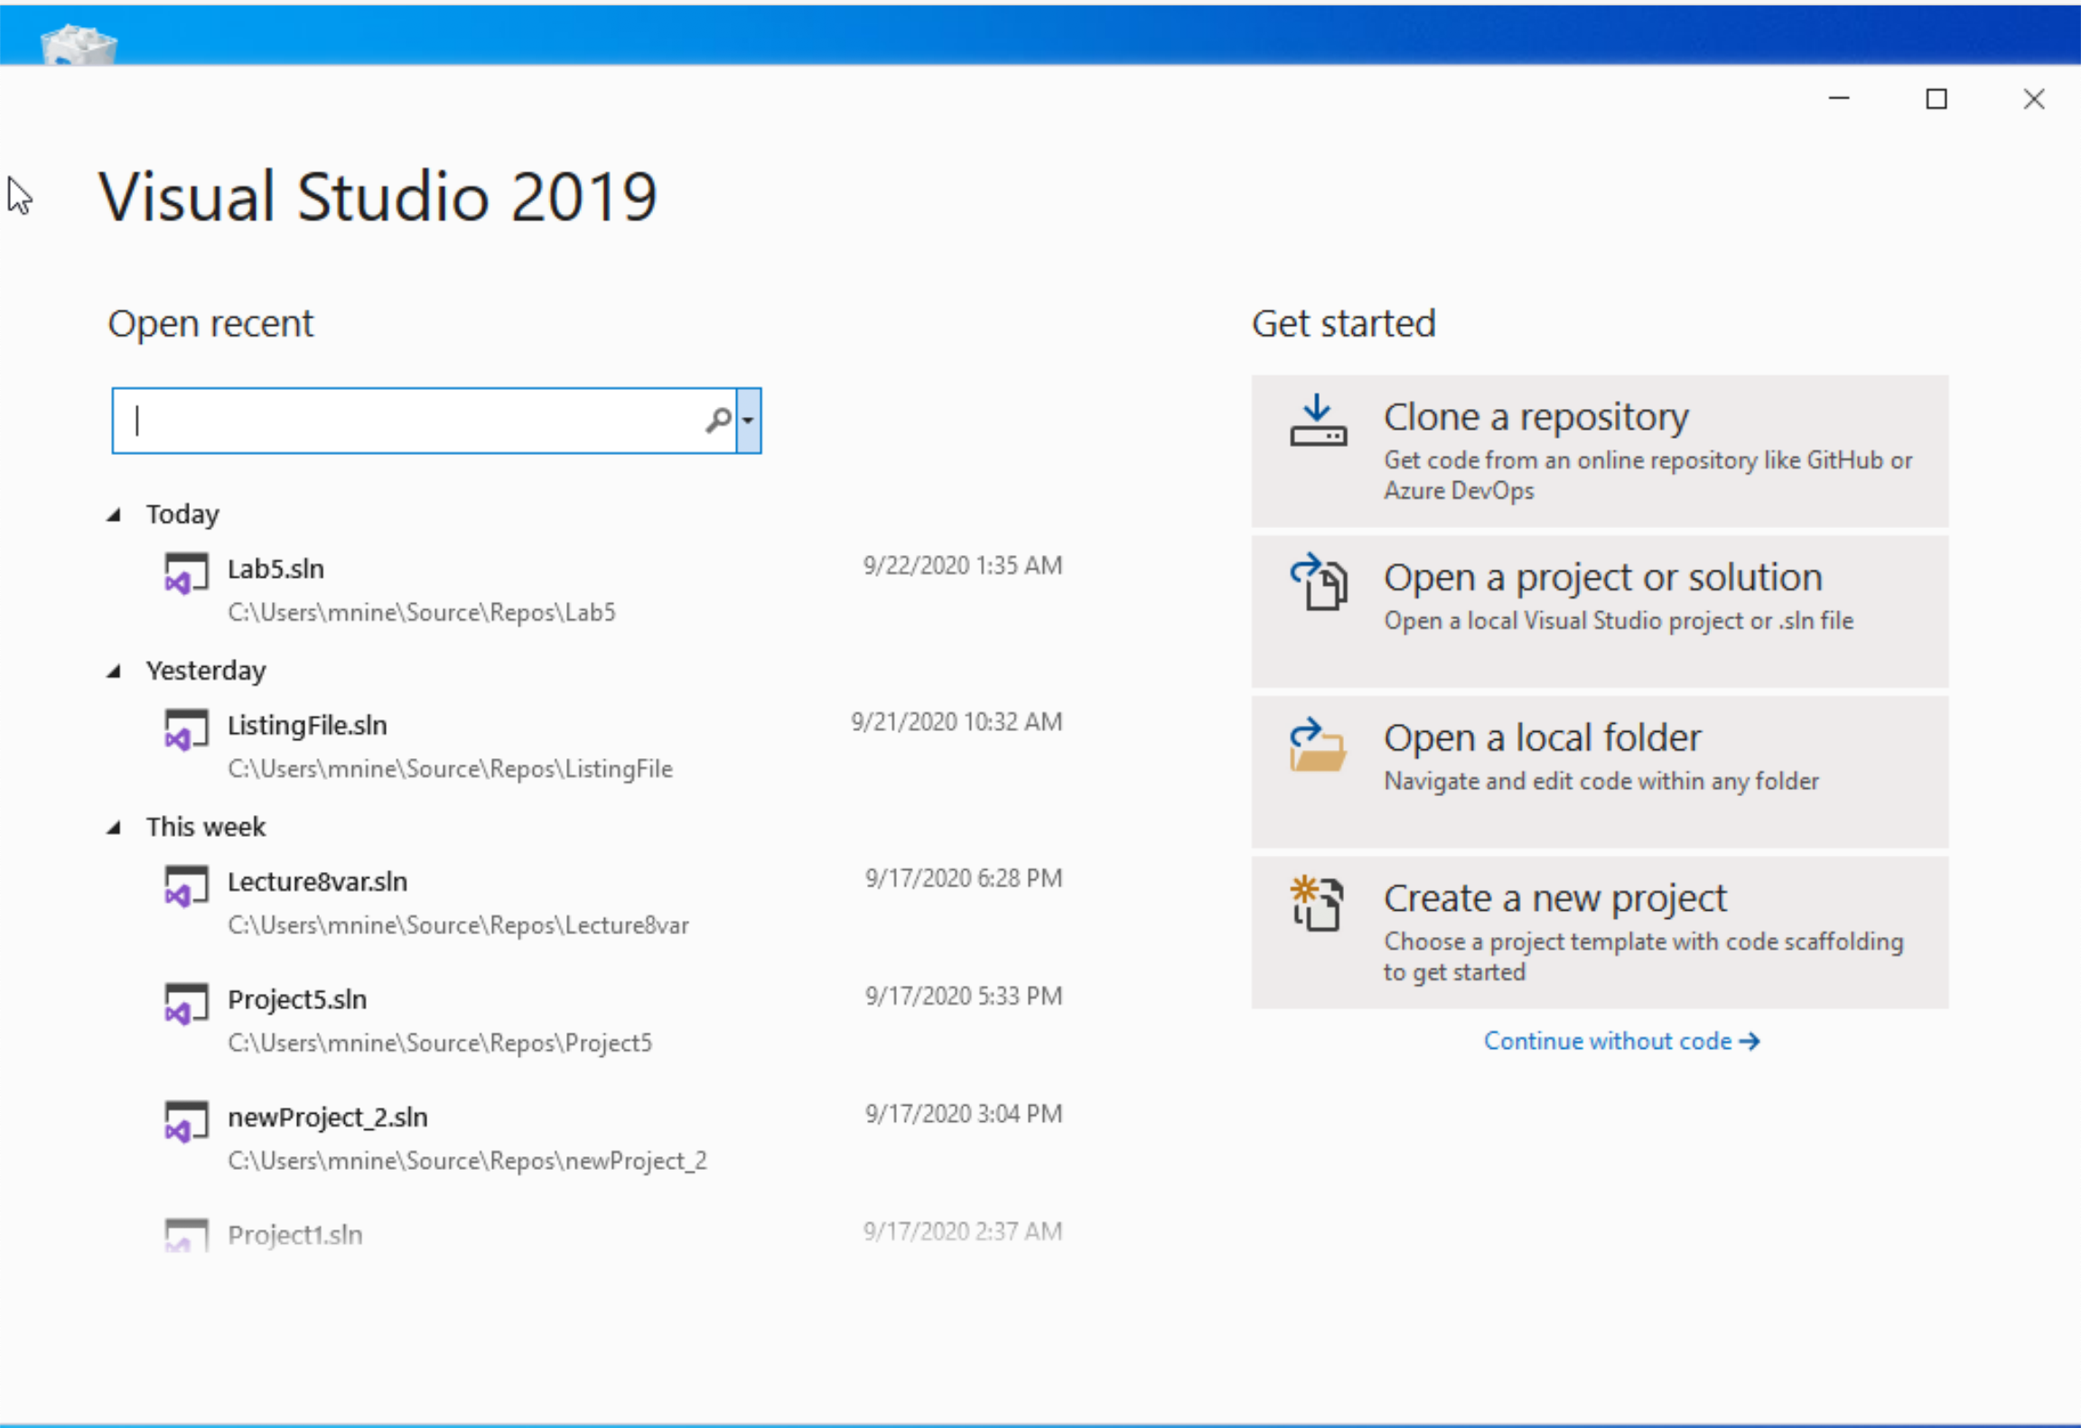


Step 1: Create a project (1)
Start Visual Studio
Click Create a new Project

Slide 26
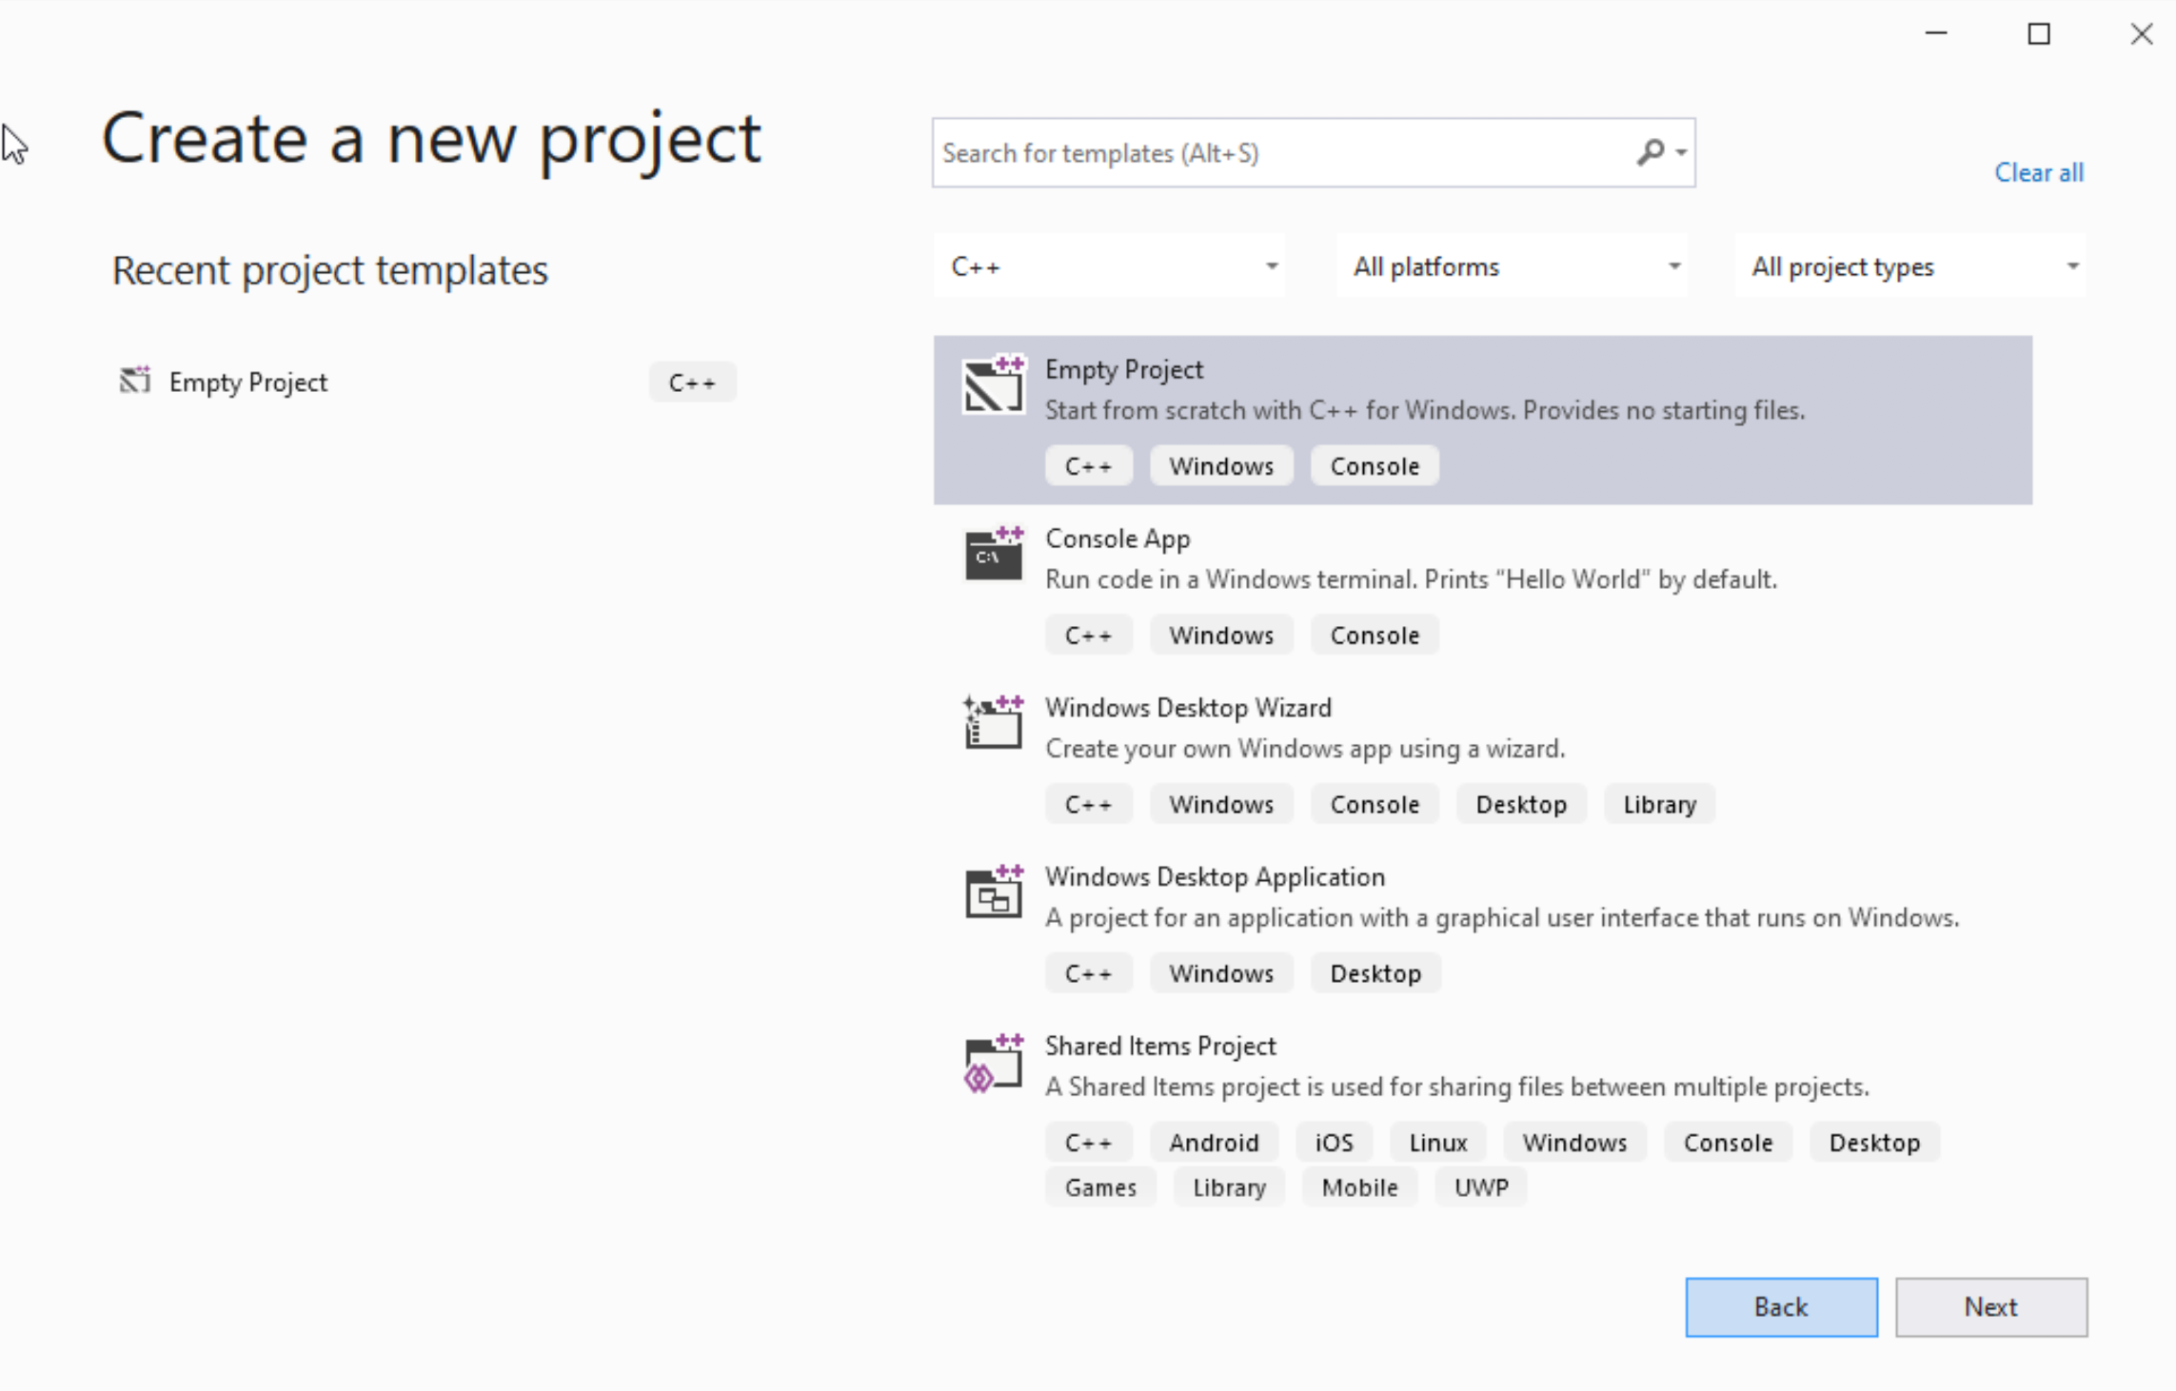




Step 1: Create a project (2)
Select C++ as language
Select Empty Project
Click Next

Slide 27
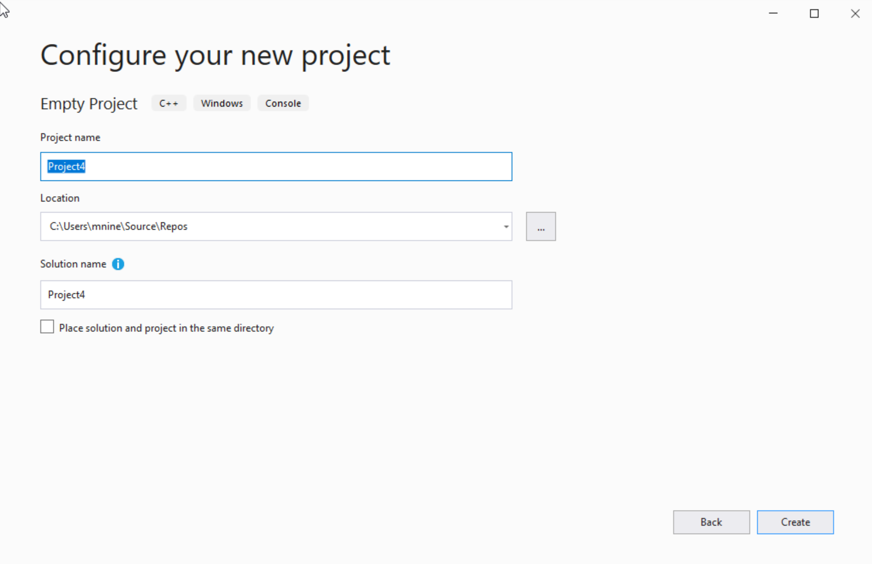

Step 1: Create a project (3)
You can change the project
name as you like
Also, you can change the
project location
Click Next

Slide 28
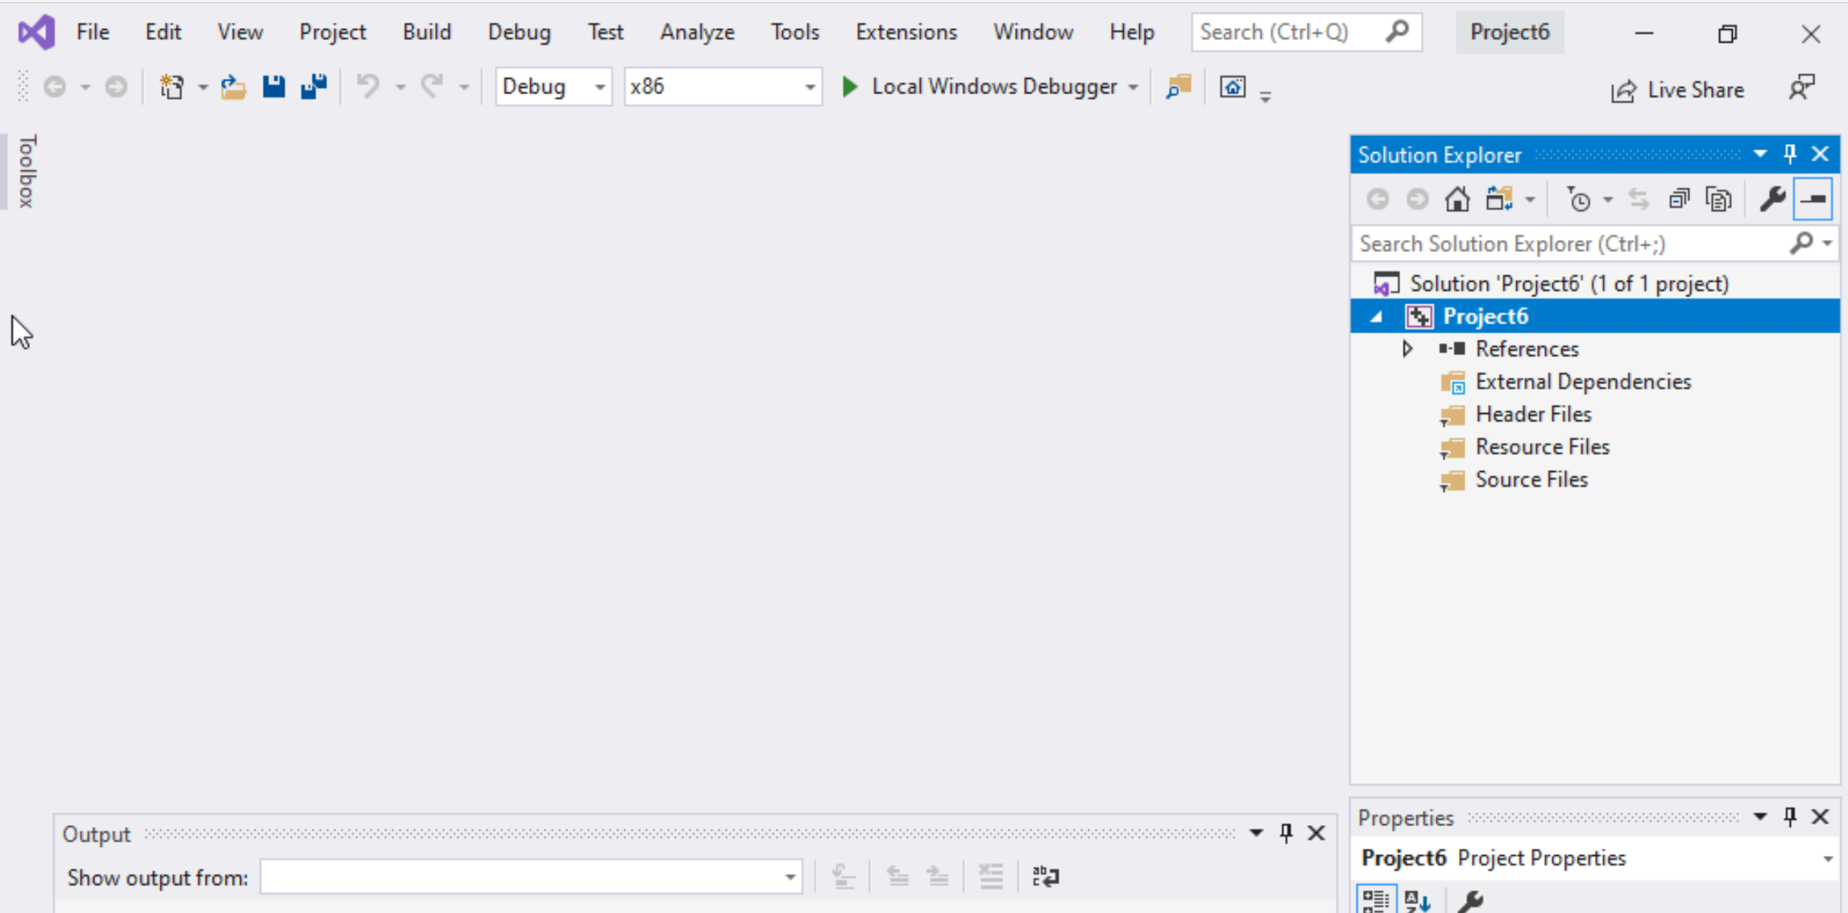
Step 1: Create a project (4)
Delete the
Following folders:
Header files
Resources Files, and
Source Files

Slide 29
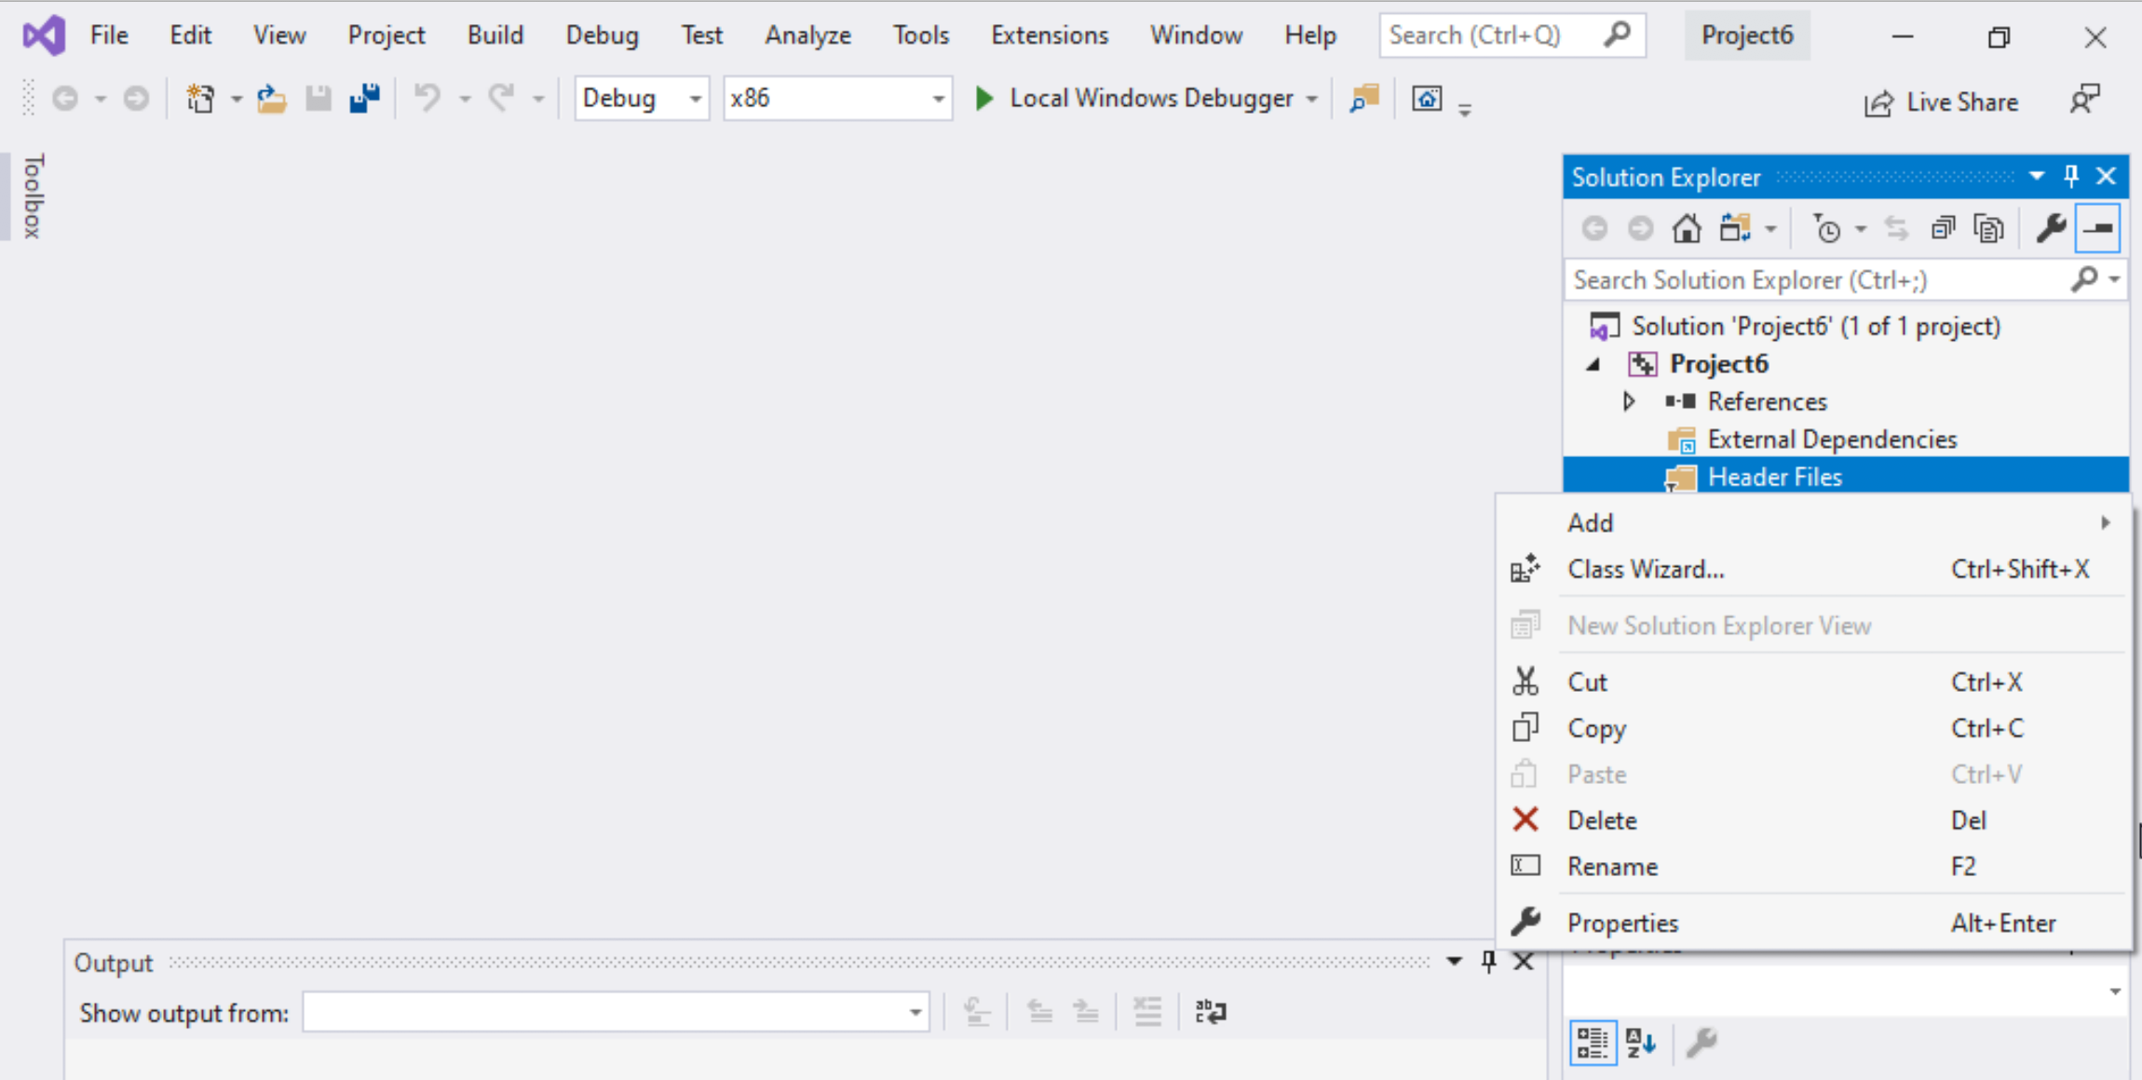
Step 1: Create a project (5)
To delete :
Select the folders
Right click on it
Select delete

Slide 30
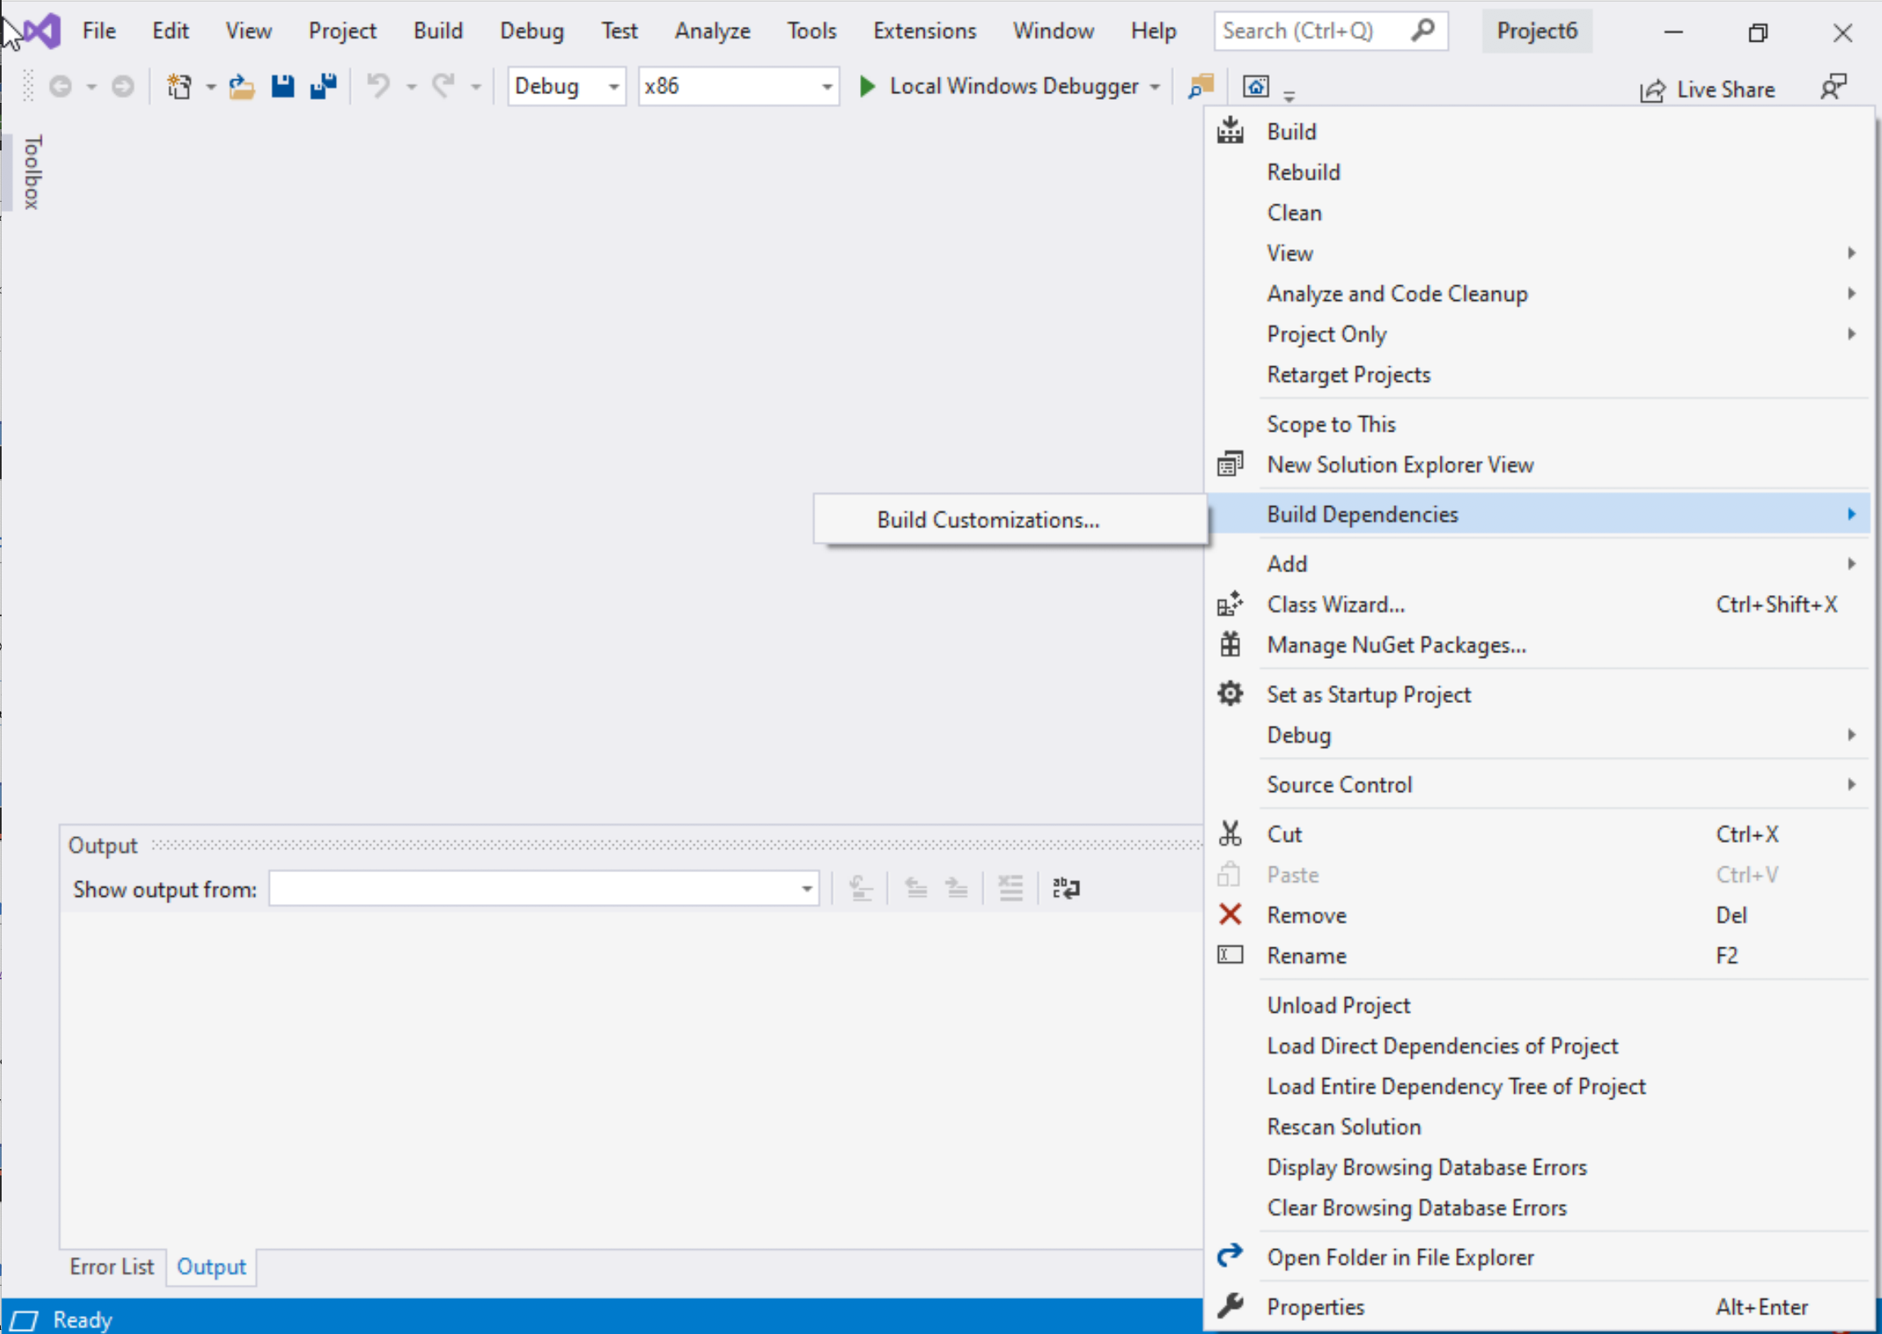
Step 1: Create a project (6)
Select Project Name on solution explorer
Right click on it
Go to Build Dependencies
Click on Build Customizations

Slide 31
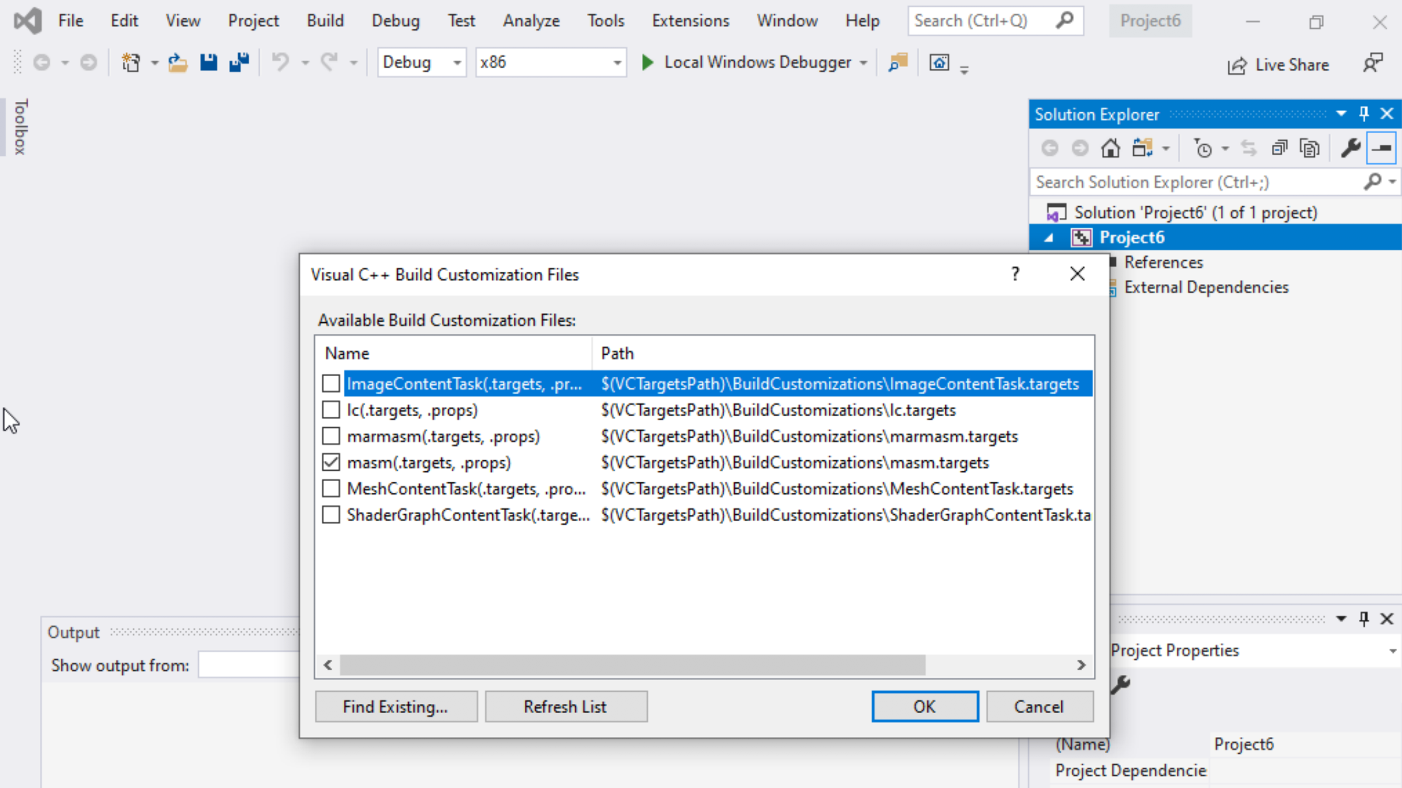
Step 1: Create a project (7)
Select masm(.target, .props)
Click ok

Slide 32
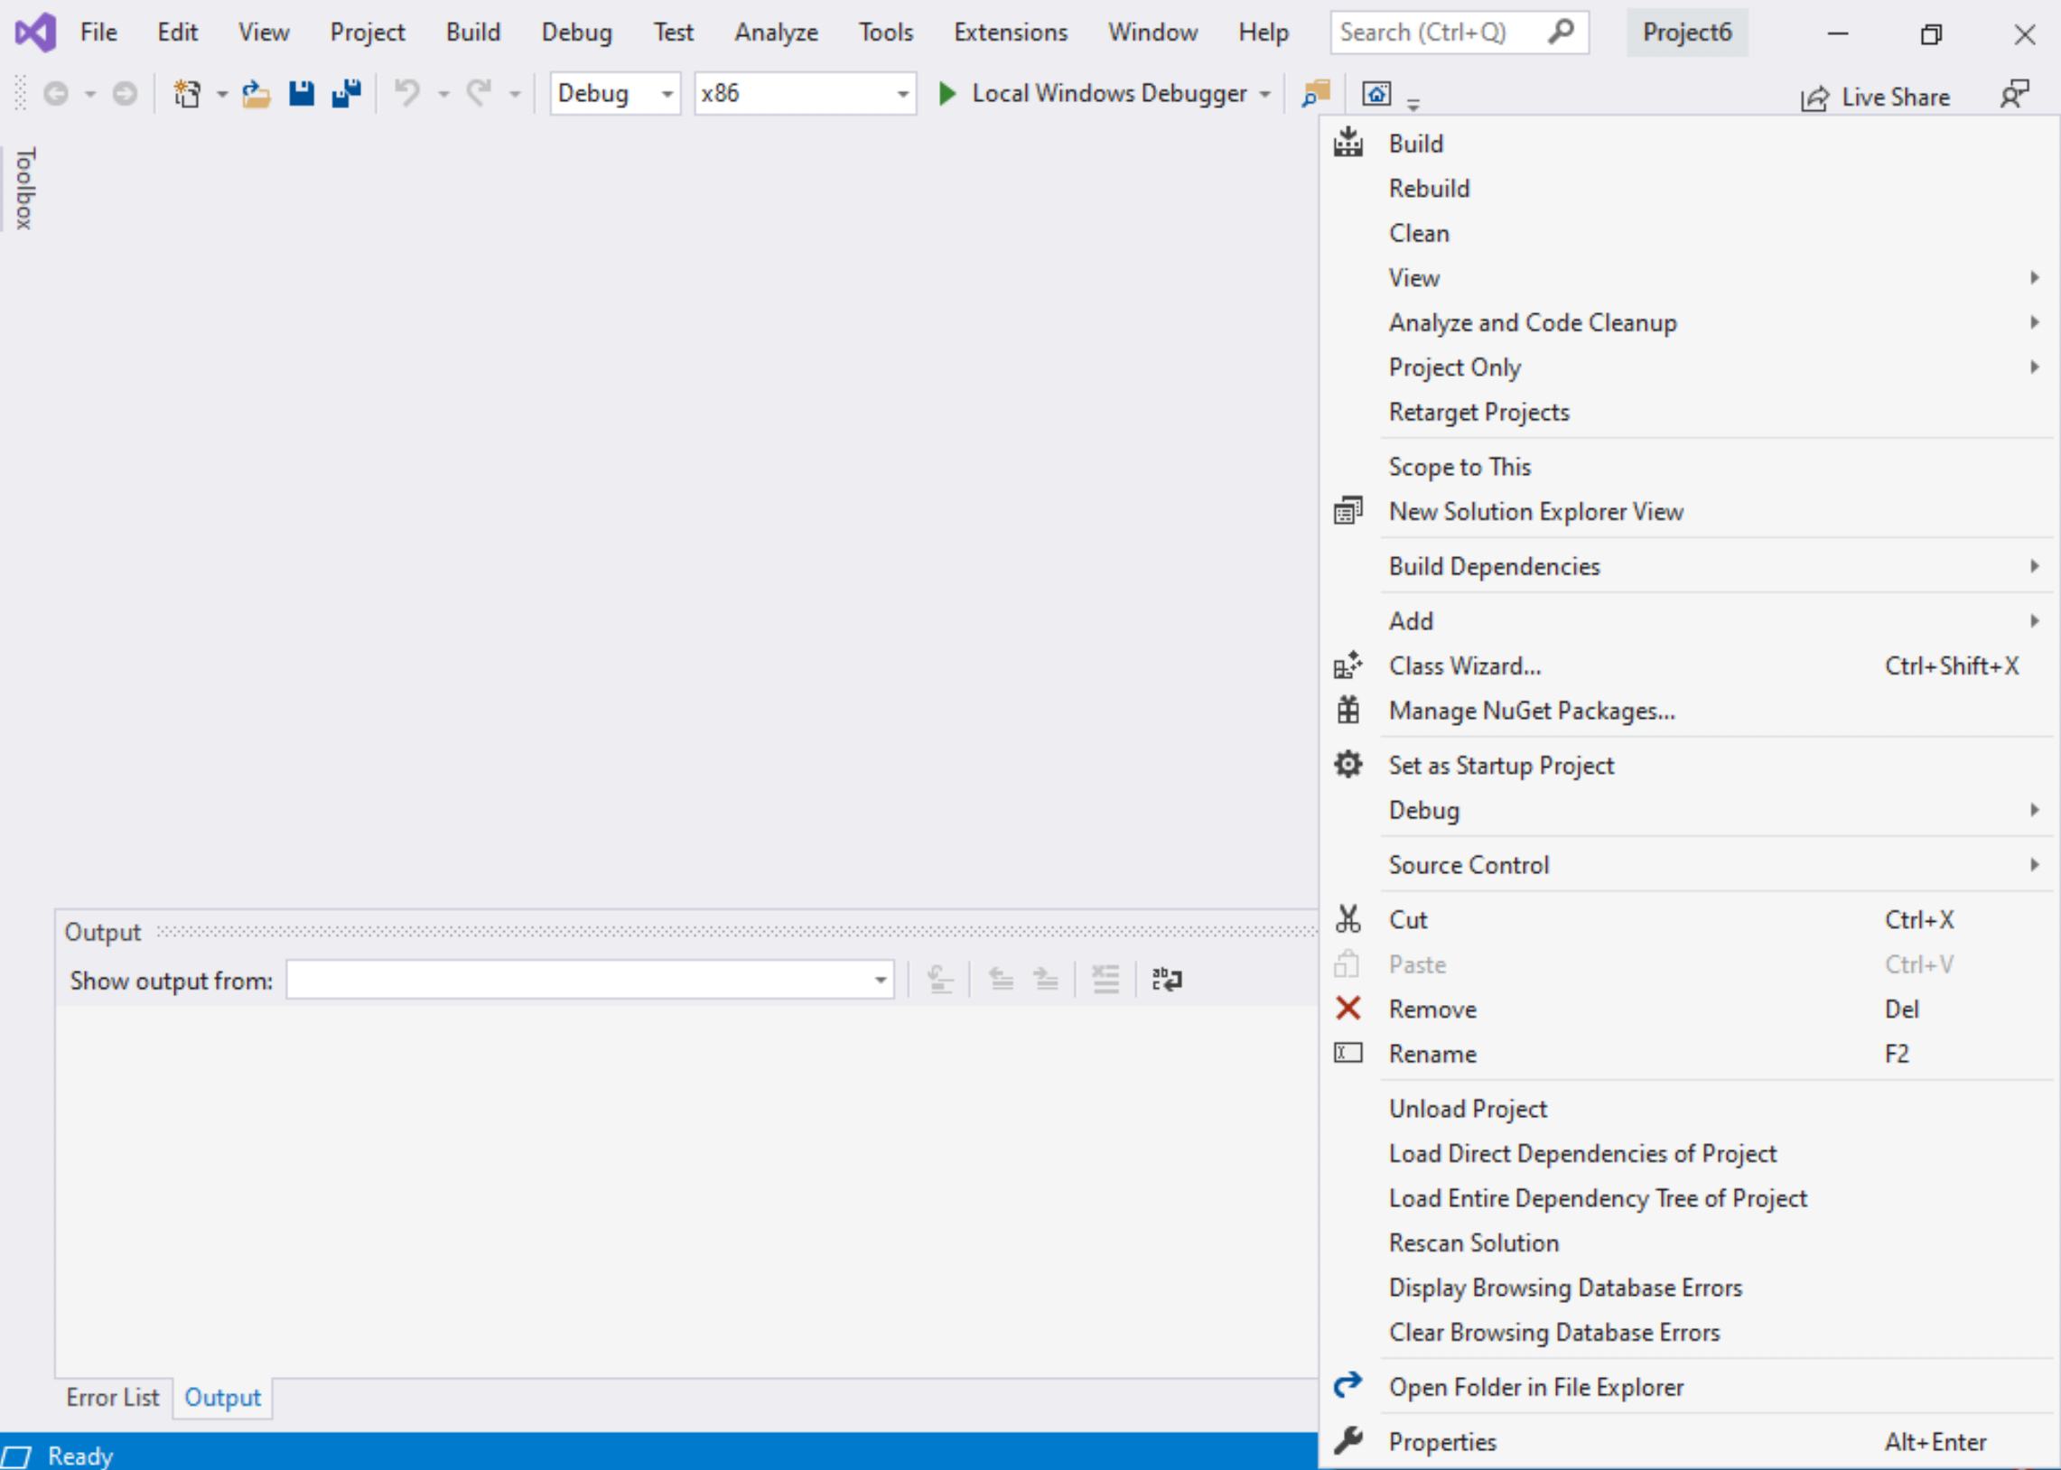
Step 1: Create a project (8)
Right click on the Project name in the solution explorer
Click properties

Slide 33
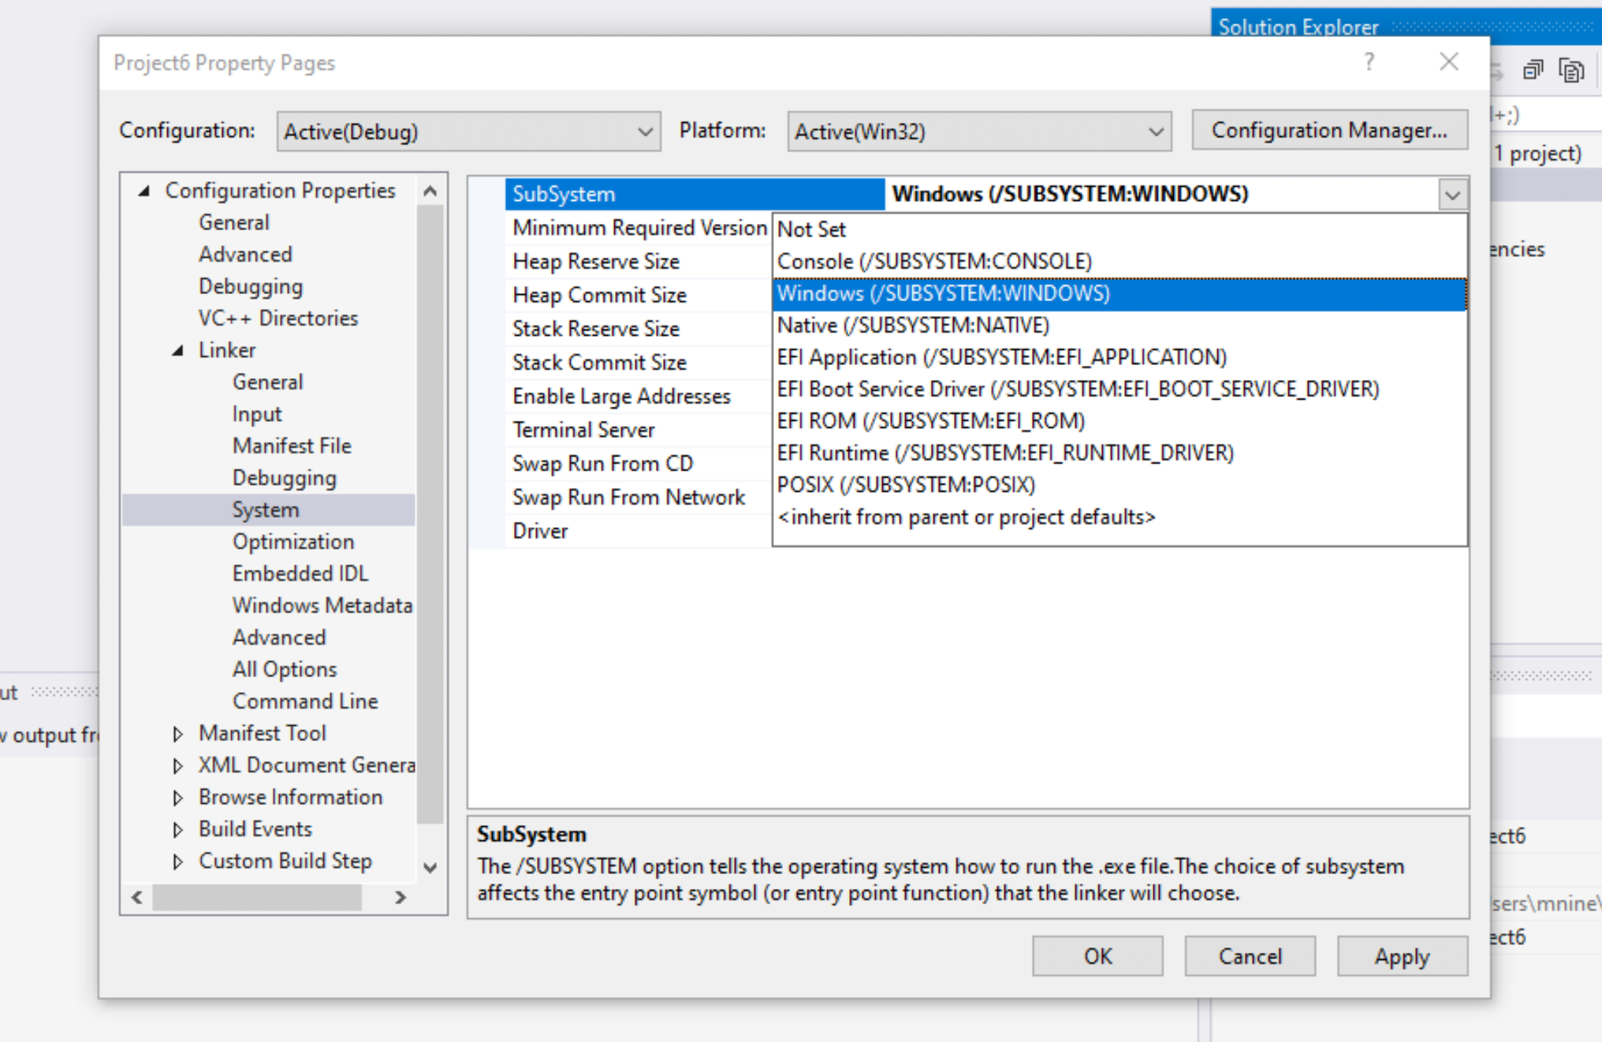

Step 1: Create a project (9)
Expand the ‘Linker’
Select ’System’
Select Windows(/SUBSYSTEM:WINDOWS)
Click OK

Slide 34
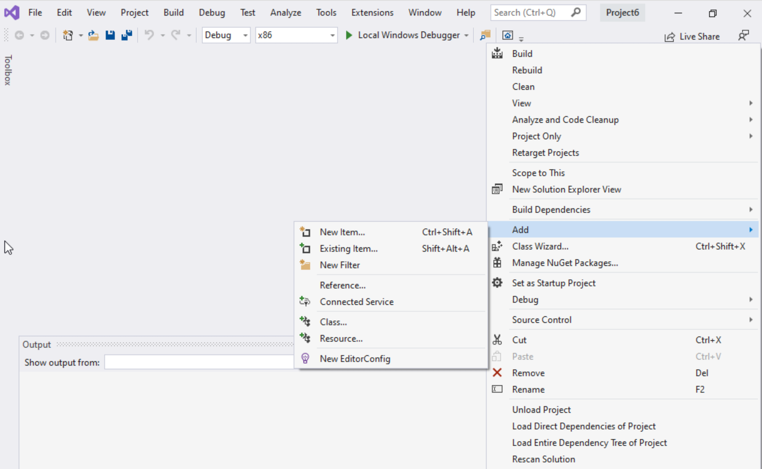
Step 1: Create a project (10)
Select Project name on solution explorer
Right click on it
Expand Add
Choose New Item

Slide 35
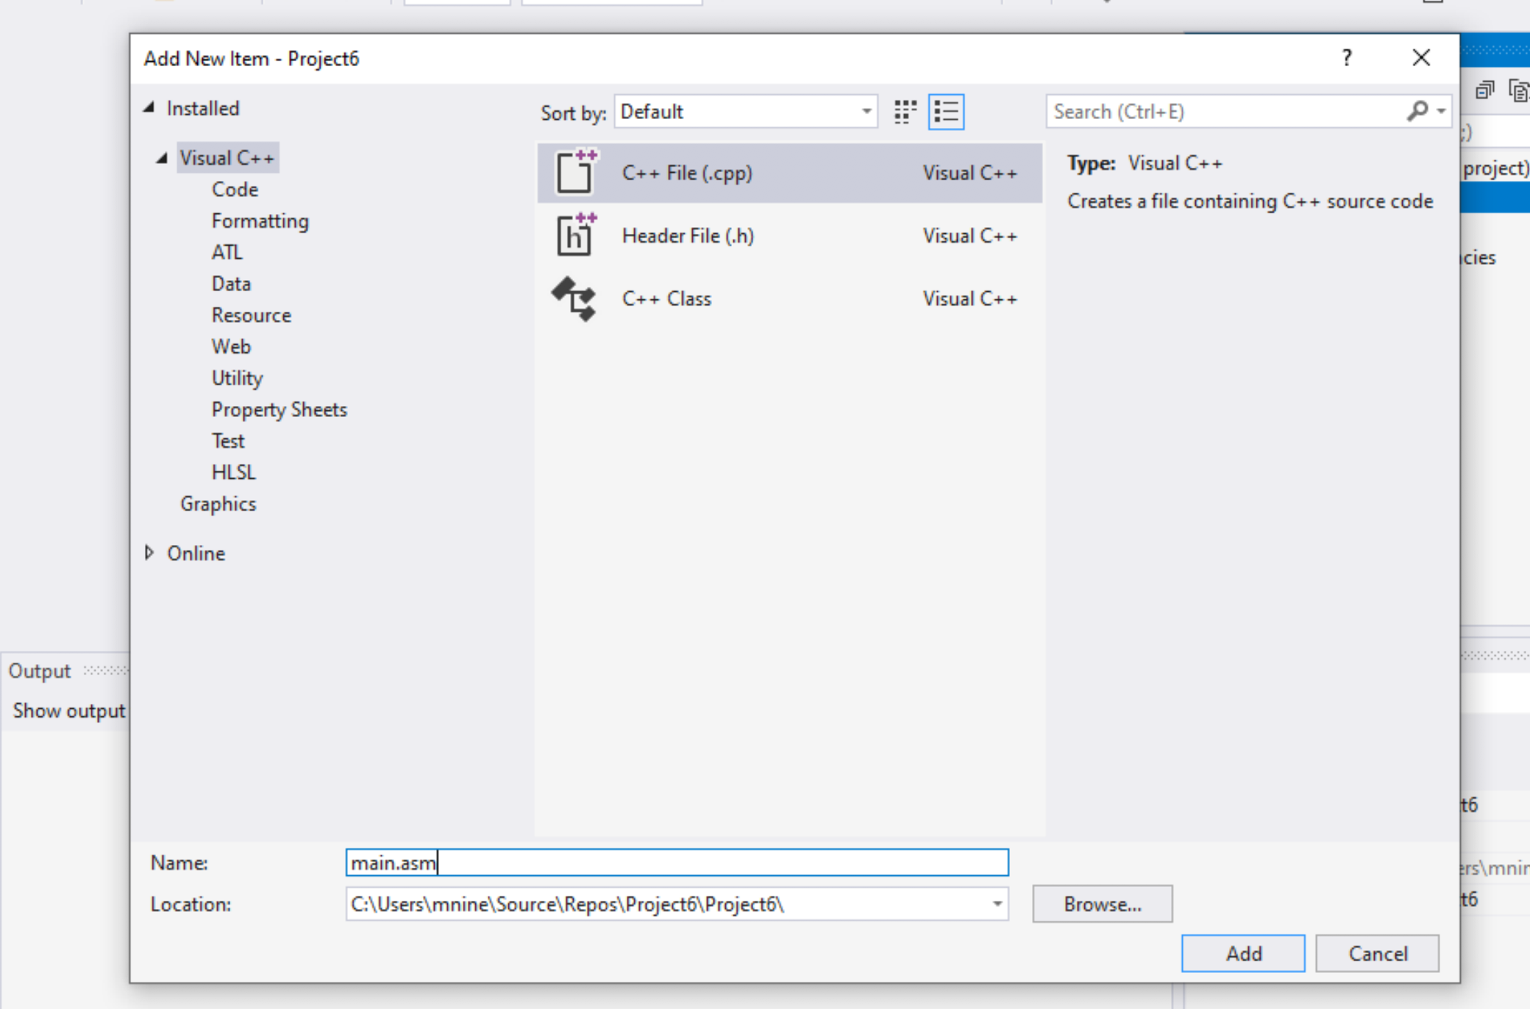


Step 1: Create a project (11)
Select C++ File(.cpp)
Name: main.asm
Click Add

Slide 36
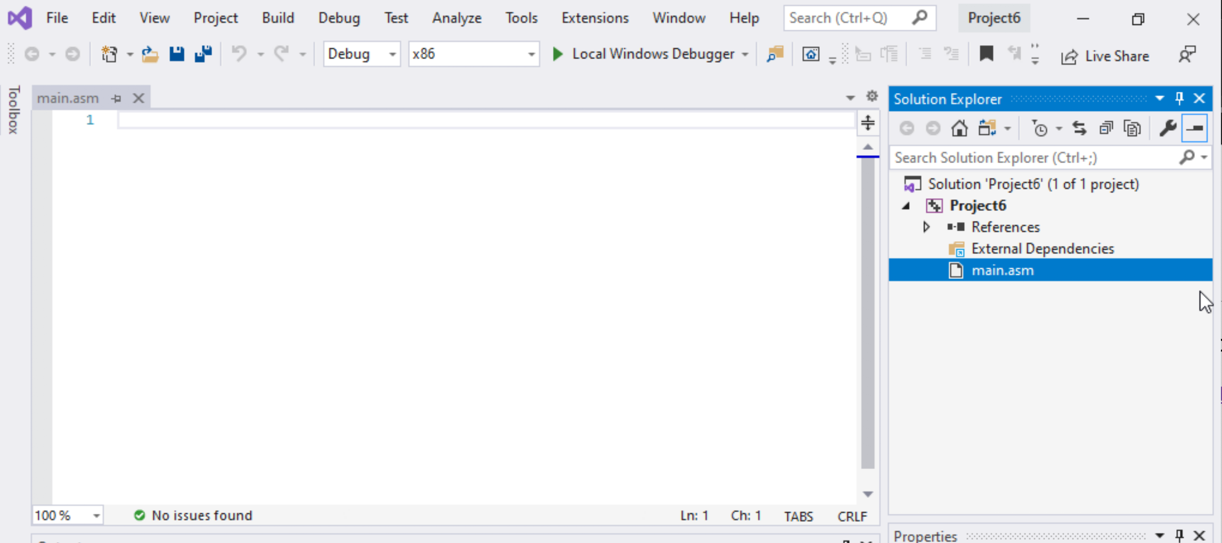

Step 1: Create a project (12)
Select main.asm
Add your code
In the main.asm File.

